Slide 1

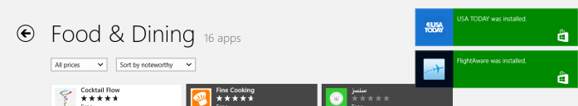

App code
Tile & Badge API Toast API
App code
Scheduled Notification API
Queue
System process
Suspended or not running

Slide 2
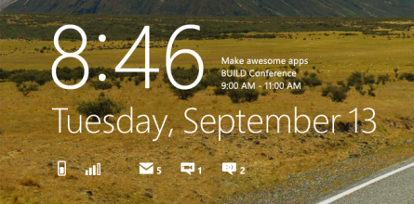
App code or manifest entry
URI
Tile & Badge Updater API
System process
REST endpoint
HTTP Request
Suspended or not running
App code
Channel Request API
Server Process
Send channel to web service
Send update
Suspended or not running
WNS
Push updates to client (system
or app code)
App code

Slide 3

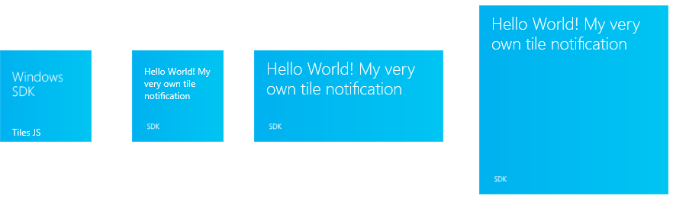
App logo
App name
Badge

Slide 4
Server Process
Other Services
Database
Mobile Service
Mobile Devices
Client App via Windows
Periodic Notification Service
Other Clients
Other Services
Web App

